Slide 1
Clash of Cos
Visual Pitch
Written by Luke Bell

Slide 2
Short Description
Top-Down Action game
Target Audience – 12+ gamers (silly, but skill level helps)
Optimize for
[I need to add images and a style/theme to slides]

Slide 3

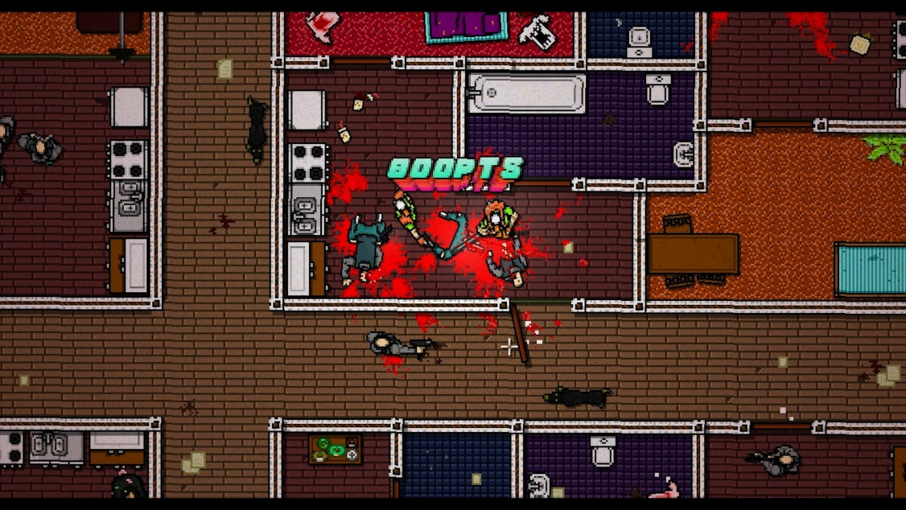
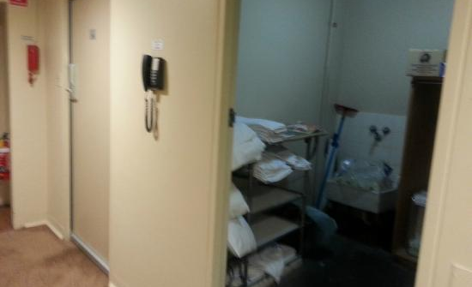
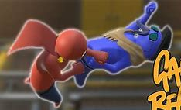
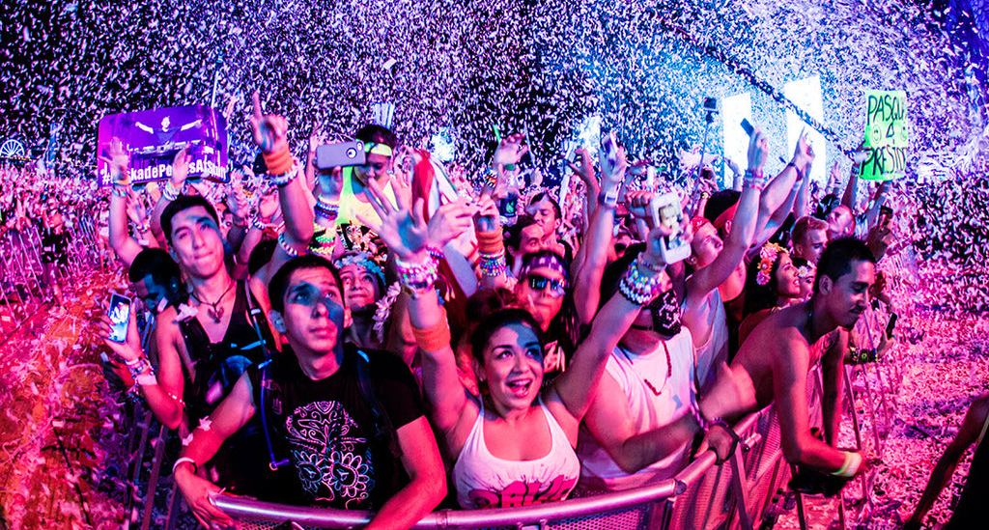
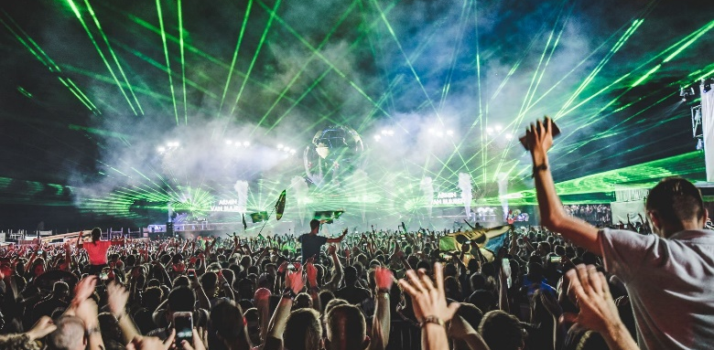
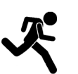

Overall Game Mood-board
Momentum – punch – knockback
Empty hotel turned (rave/show) fight club

Slide 4
Narrative Context
This is a show
Ran by enthusiasts with time to spare
they wear costumes then fight each other for entertainment

Slide 5
Player Character
A new contestant!

Slide 6
Mechanics and Gameplay

Slide 7
Gameplay Mood-board

Slide 8
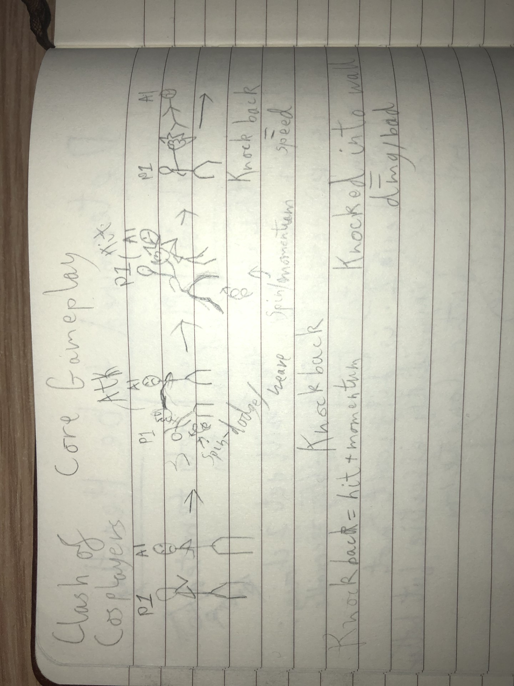
Core Gameplay
Weave/dodge swing/attack ragdoll/knockback/damage

Slide 9
Knock back

Slide 10
Interaction
[Controls layout]

Slide 11
Equipment
We don’t need many buttons, so we could bind each equip key to corelating socket

Slide 12
Items

Slide 13
[Item-Category] Trolley

Slide 14
Threats

Slide 15
Basic Thug
We can add enemy variety with different weapons/equipment
Bosses could also add variety (if we perscribe sufficient time)
No weapons (so little damage)
Only option is to attack player with melee
{maybe we allow friendly fire – helps with the repetitive nature of melee enemies ganging up on the player, and also entertaining}
[each enemy weapon type we use will have it's own slide to allow for more detail]

Slide 16
Zeus – AI Boss Enemy
Takes more hits to beat
Can use lighting to damage and stun/ragdoll player
Defeat gives Taser

Slide 17
World Mechanics

Slide 18
Wall Bounce
Knock back into wall deals little extra damage [additional cool thing to make combat more varied]

Slide 19
Conveyer Belt
[Very gangbeasts – also additional]

Slide 20
Terrain that is item
Tables and furniture and stuff that player can use as a wall or cover, but also pick up for shenanigans (violence) [also additional]

Slide 21
Non-Player Characters

Slide 22
Announcer
Basicaly Narator
They explain things
Game is basicaly a game show that they announce [either text or voiced dialogue would work fine]
They are a hype man, they're dramatic, and snarky

Slide 23
"Zeus"
[explanation of double Zeus entry]While they are a threat, they're presence as an NPC would be separate from Zeus the threat if we did not make the connection clear (through label and narative context)
Will talk shit
Talk about the good fight (even if they lost – like they're trying to save face)
Will break character eventually
Egotist nerd

Slide 24
Game to Player Feedback
Ways the game will convey information to the player
Combat
Ragdolls need to be Obvious
Ideally sound effect indicate impact/damage
Progress indicators
An enemy count could work
Anoucer comments
Boss Talks

Slide 25
Level Designs

Slide 26
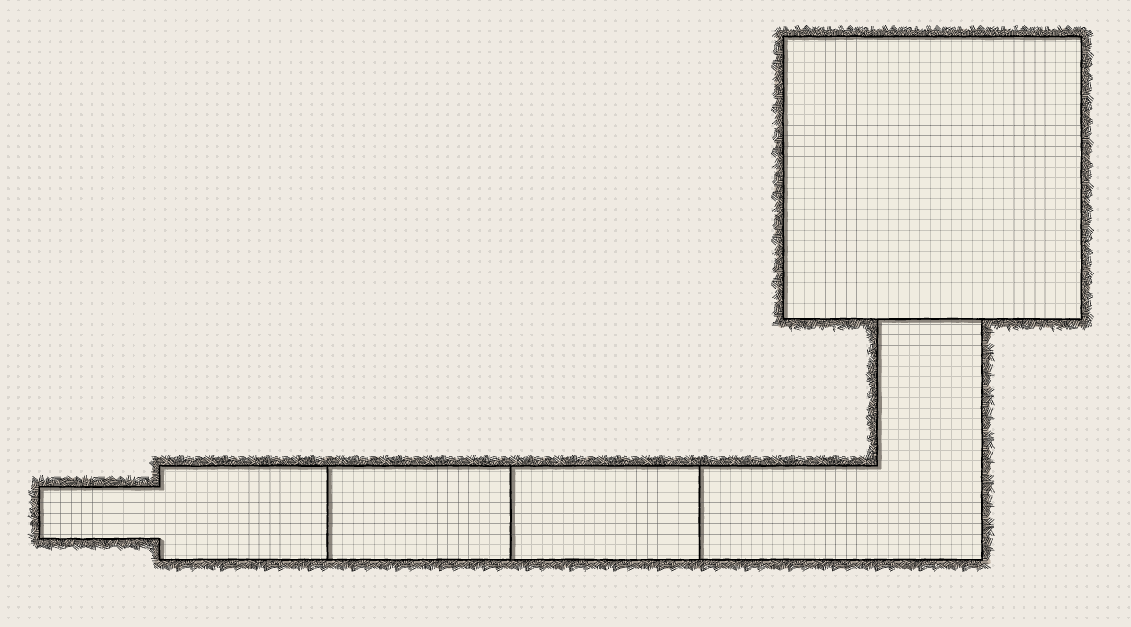
Tutorial Design Sketch

Slide 27
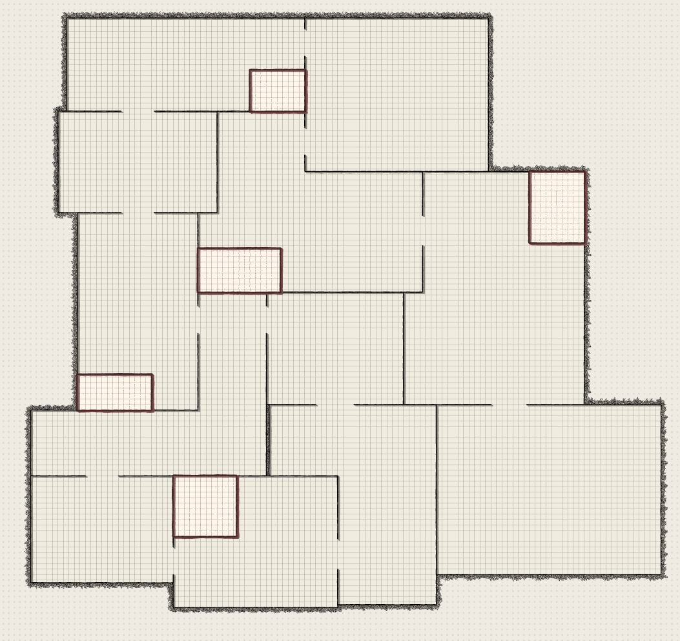
1st Level Design Sketch

Slide 28
Questions

Slide 29
Posible Questions
How is this different from other top-downs
How would you sell/monatise this
What problems did you encounter/deal with
Why this mechanic
How would you improve it

